Slide 1

WELCOME TO MY PRESENTATION
NAME: S. M. Rafi Alam
ID: 17201053
Sec: A(2)

Slide 2
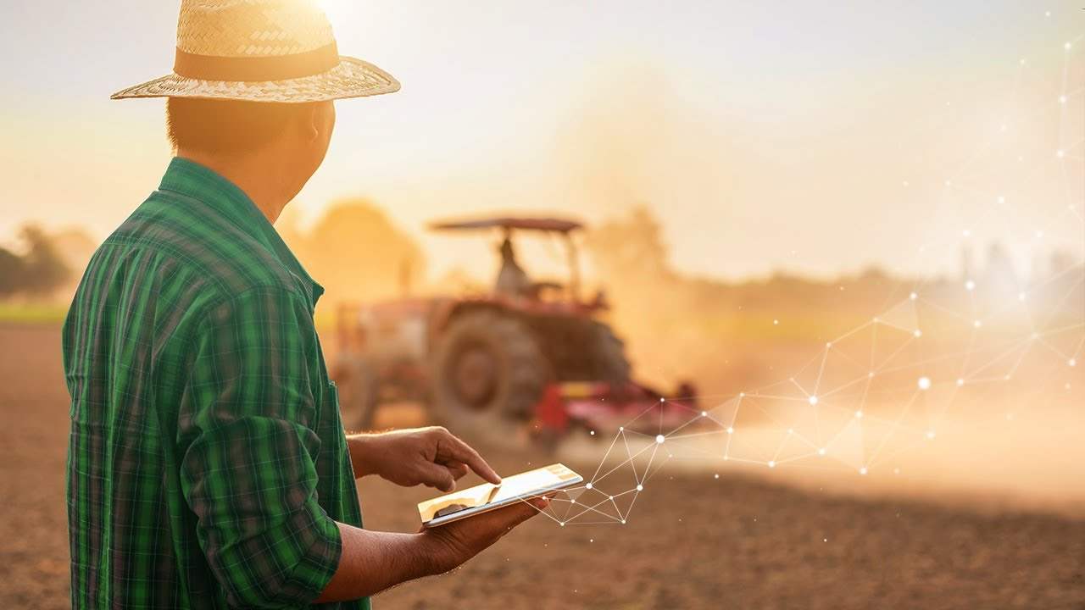

Agriculture & Technology Management System

Slide 3
Introduction:
“Agriculture & Technology Management System” is farmer management website application which helps farmers to give best-practice farming processes. It helps farmers to improve their productivity and profitability. It enables farmers to sell their products online and farmers can purchase tools and seeds directly from seller. Farmers can view labours profile and they can hire labours.

Slide 4
Purpose & Objectives:
The main objective of developing “Agriculture Management System Project” application is to help farmers by providing all kinds agriculture related information in the website.
The other objectives of our project is to create job opportunity for Agricultural base people like farmers.
Another is for the general people (who are interested in Agricultural sector) get satisfied with our technology.

Slide 5
Features:
Administrators
Users/Customers
Farmer’s/Sellers
Laborer
Products(Machineries,Seeds,etc)

Slide 6
There are 4 kinds of users for the proposed system:
Administrators: Administrators are the ones who can add or administer the categories for the products and administers the all website information’s. Administrator has full privilege of the website.
Sellers: Sellers are the farmers and they can sell their productions through online after the registration After the registration the farmers can login to the system by entering login id and password.
Customers: Customers can buy products through online The customer can send purchase request to check the quality of the products.
Laborers: Laborers can receive various work requests from multiple farmers and they can also reject or approve a request depending upon their interest.

Slide 7
Weekly Update:
Front End with HTML
UI design with CSS
Interaction with java Script
ER Diagram and Schema diagram
Creating Database with My SQL
Connecting the Database with Django
User sign up, sign in, sign out and profile page implementation

Slide 8
Future Plan
Agriculture is one of the most important areas of human activity worldwide. As the population rises there is a need to increase the agricultural production. Agricultural modernization due to commercialization, land-saving and labor intensive production between 1870 and the 1920s doubled agricultural production per land area.
Over the past 15 years however, farmers started using computers and software systems to organize their financial data and keep track of their transactions with third parties and also monitor their crops more effectively. In the Internet era, where information plays a key role in people’s lives, agriculture is rapidly becoming a very data intensive industry where farmers need to collect and evaluate a huge amount of information from a diverse number of devices (e.g., sensors, farming machinery, meteorological sensors, etc.) in order to become more efficient in production and communicating appropriate information.
Nowadays, a number of proprietary solutions have been developed to help farmers manage their farms in an effective way. Most of the Farm Management Systems focus on specific tasks and use their own specifications to implement the functionality provided. Currently, these systems are slowly moving into the Internet era and are starting to use some of the well-established networking solutions to improve what they offer to the end users. FMSs have also started to become ‘‘coupled’’ mainly with some farming equipment (e.g. actuators) to allow the automatic execution of decisions if this is desirable from the farmers.
Currently, A&TS are providing significant services, but their capabilities can be greatly improved. The goal is that future systems should provide universal market places for the publicizing, evaluating and subscribing for agricultural related services in a plug and play manner.

Slide 9
THANK YOU ☺

